Slide 1
PETCHISHRI S 821721104037 B.E Computer Science of Engineering – IIIyear Sir Issac Newton College Of Engineering And Technology
3/21/2024 Annual Review

Slide 2
PROJECT TITLE
Audience Research
(using CNN)

Slide 3


AGENDA
The agenda of Audience research using Convolutional Neural
Networks (CNNs) involves the use of deep learning techniques to research
Audience.This project includes several key tasks:
Data Collection
Sentiment Analysis
Text Processing
Network Analysis
Visualization
This task has several broader objectives and potential applications
3/21/2024 Annual Review

Slide 4

PROBLEM STATEMENT
The challenge is to develop a scalable and efficient system that gathers and processes vast amounts of data from various sources such as social media, website interactions, and viewer feedback.
This research aims to enhance content personalization, improve viewer retention, and ultimately optimize CNN's programming strategies.
The challenge includes integrating machine learning algorithms for sentiment analysis and recommendation systems to tailor content to diverse audience segments, fostering deeper viewer engagement.
3/21/2024 Annual Review

Slide 5

PROJECT OVERVIEW
The project aims to conduct audience research for CNN using Python, focusing on data collection, analysis, and visualization to understand viewer preferences and engagement patterns.
Through web scraping, sentiment analysis, and machine learning techniques, the project seeks to provide insights into audience demographics, content preferences, and engagement metrics for optimizing content strategy and enhancing viewer satisfaction.
3/21/2024 Annual Review

Slide 6

WHO ARE THE END USERS?
End users for audience research in CNN using Python could include media analysts, marketing professionals, data scientists, journalists, content creators, and advertising strategists.
They leverage Python scripts to analyze viewer demographics, engagement metrics, and content preferences to inform content creation, advertising campaigns, and audience targeting strategies.
This research aids in understanding viewer behavior, optimizing content delivery, and maximizing audience reach and engagement for CNN’s digital platforms.
3/21/2024 Annual Review

Slide 7

YOUR SOLUTION AND ITS VALUE PROPOSITION
Solution: Utilize Python’s libraries like BeautifulSoup and Requests to scrape CNN’s website for articles. Then, apply Natural Language Processing techniques to analyze audience engagement, sentiment, and topics. Finally, visualize the findings using libraries like Matplotlib or Plotly for easy interpretation. Value Proposition: Our Python solution offers a cost-effective and efficient way to gather insights into CNN’s audience preferences, sentiment, and trending topics. By automating the data collection and analysis process, it enables timely decision-making and targeted content creation strategies for CNN’s audience.
3/21/2024 Annual Review

Slide 8

THE WOW IN YOUR SOLUTION
Wow! Uncover audience insights with CNN audience research using Python’s powerful libraries like TensorFlow and Keras. Analyze viewer preferences, demographics, and engagement patterns to tailor content for maximum impact.
Visualize data with stunning graphics using Matplotlib and Seaborn. Implement cutting-edge deep learning algorithms to predict viewer behavior and optimize content strategy.
3/21/2024 Annual Review
8

Slide 9
MODELLING
In Audience Research, effective modeling is the cornerstone of success, and our approach is engineered to excel in this crucial aspect.
Our modeling strategy involves a blend of innovative techniques such as convolutional neural networks (CNNs), recurrent neural networks (RNNs), and attention mechanisms, carefully orchestrated to extract and leverage meaningful features from images with unparalleled accuracy and efficiency.
In essence, our modeling paradigm represents a beacon of innovation, driving transformative advancements and unlocking new frontiers in the field of computer vision.
3/21/2024 Annual Review
9

Slide 10
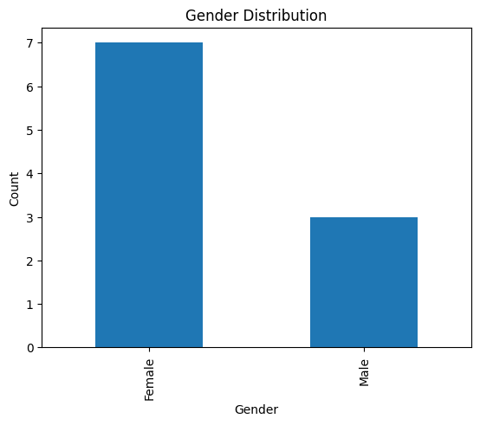
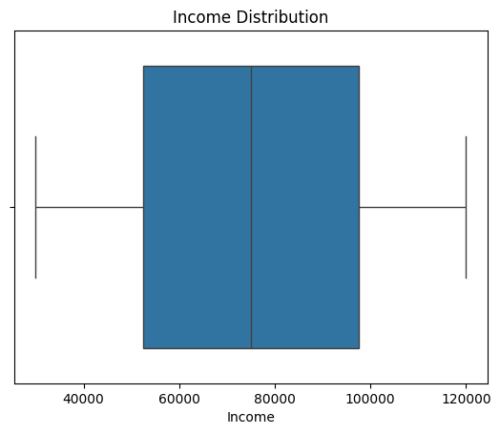
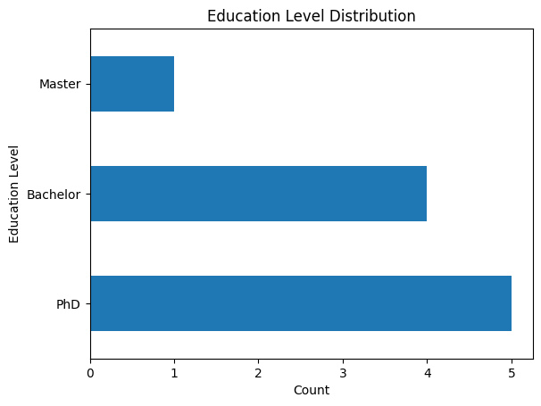
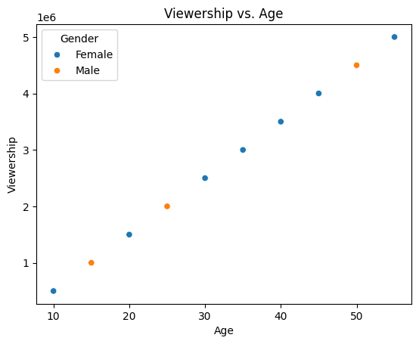
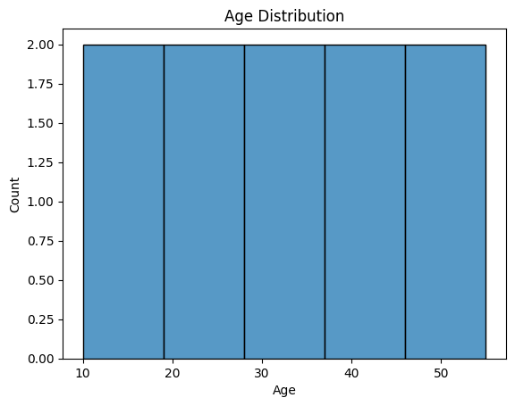
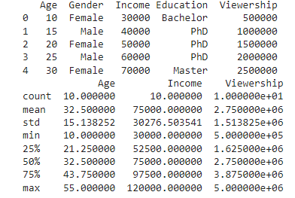
RESULTS
Demo Link
3/21/2024 Annual Review
10

